Slide 1

Parklux
Hello, I’m
Muhammad Habib
Your future developer to Blibli.com
https://bit.ly/parklux

Slide 2
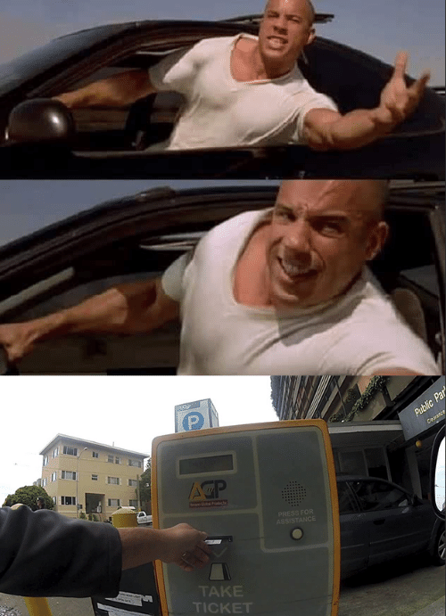
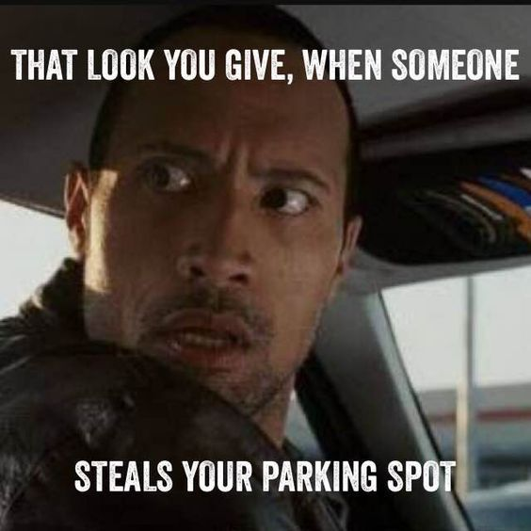
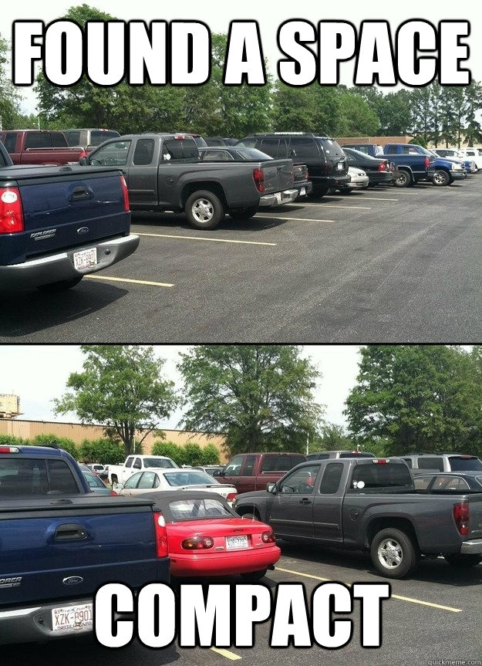
Parklux

Slide 3

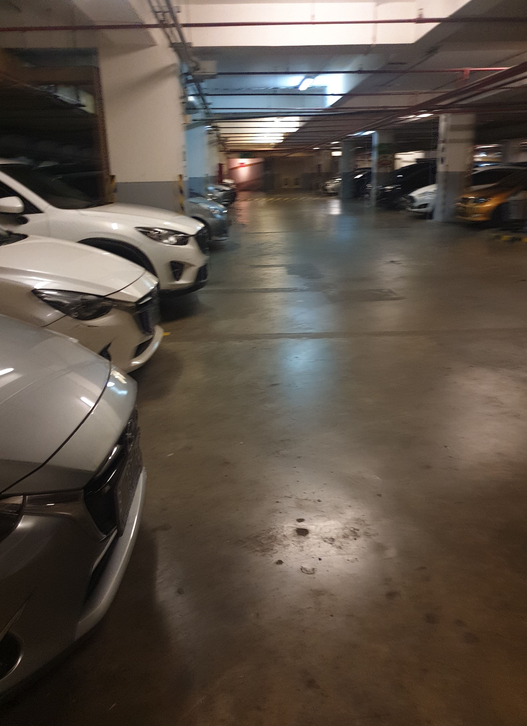
Parklux

Slide 4


Manage Parking Zone
Parking Receipt
USER
STORY
See Registered Parking Zone
Get parking slot directly

Slide 5
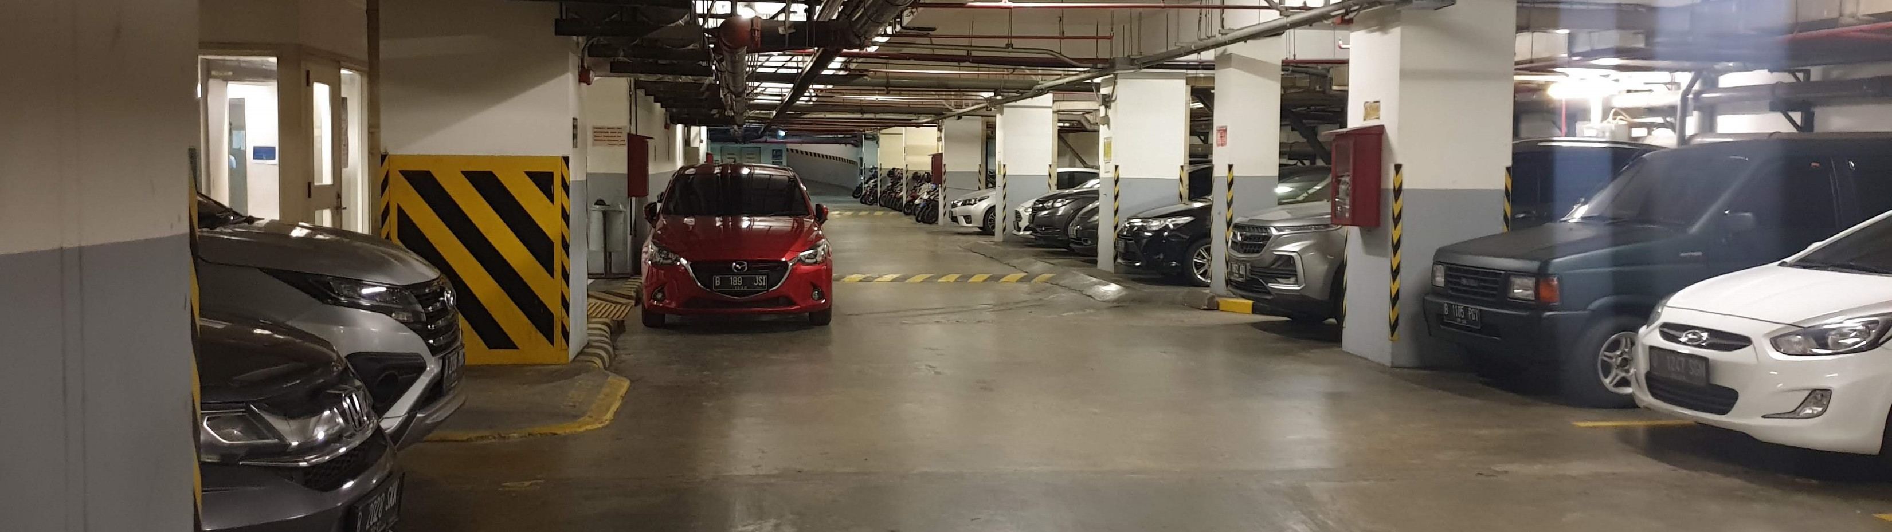


USER ROLE
CUSTOMER
ADMIN
(Parking Zone)
SUPER ADMIN

Slide 6
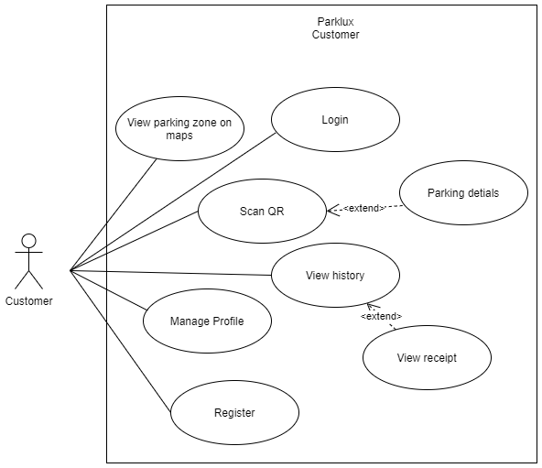
USE
CASE
Parklux

Slide 7
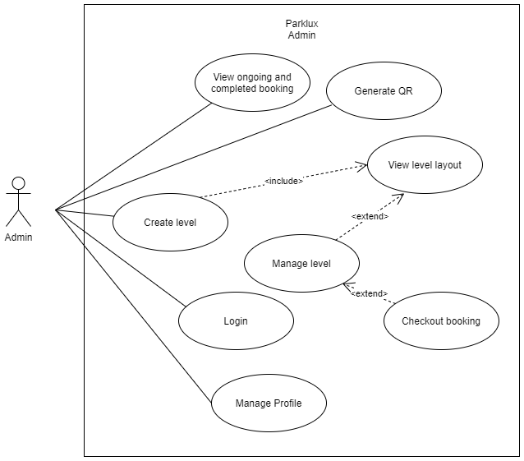
USE
CASE
Parklux

Slide 8
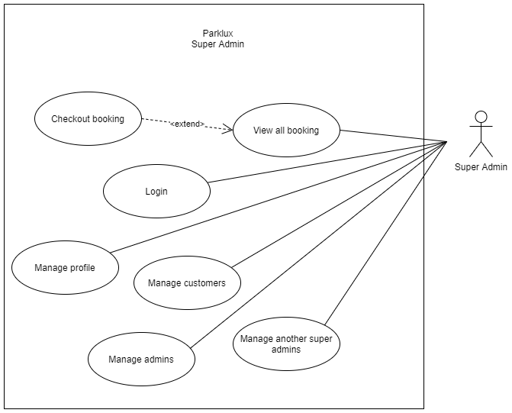
USE
CASE
Parklux

Slide 9
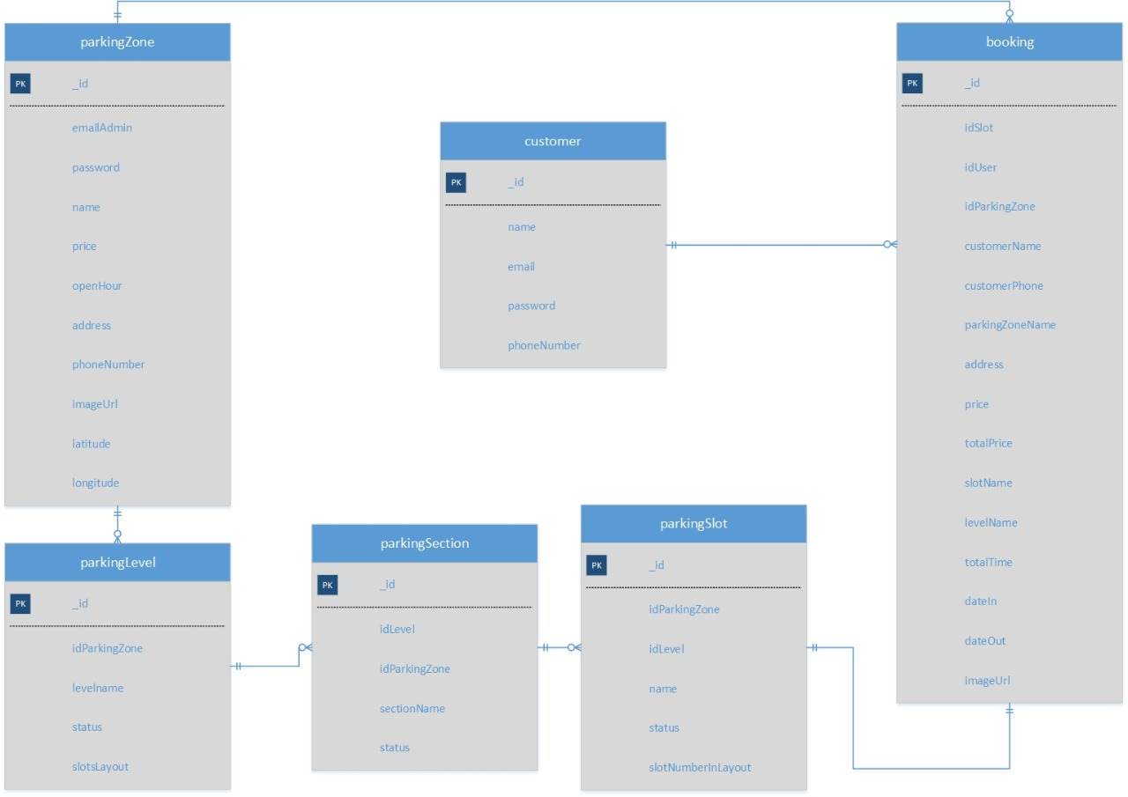
ERD
Parklux

Slide 10








Technology
Parklux

Slide 11

Parklux
DEMO

Slide 12

FUTURE
DEVELOPMENT
Flexibel price/hour or with a diffrence price between first or second hour, and specify the vehicle
Generate the slot nearest with enterance not just random
Can provide payment system any payment systems like Blipay or etc,
Adjustable layout sizes
Parklux

Slide 13
THANK
YOU
Parklux

